Slide 1
Project 1 Matthew Larson

Slide 2
Board game store
Board game data from https://www.kaggle.com/datasets/melissamonfared/board-games
Tech stack:
MongoDB
Python
Git

Slide 3
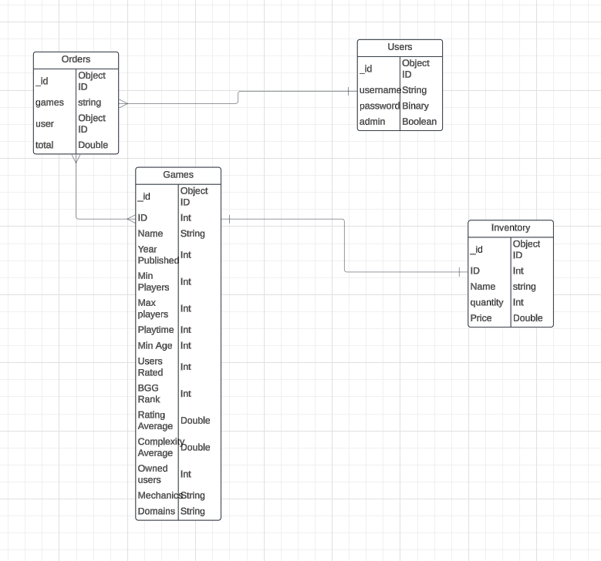
ERD

